Slide 1
SSHRC Insight Grant: Strategies for Success
July 21, 2022 @ 10:30 am – 12:00 pm
Thank you for joining us, the session will begin shortly
You are currently placed on mute
Reminder: this session will be recorded and transcribed
[add Canva promotions image here]

Slide 2
SSHRC Insight Grant: Strategies for Success
July 21, 2022 @ 10:30 am – 12:00 pm
Prof. Becky Chen
Professor, Ontario Institute for Studies in Education
Prof. Michael Miller
Assistant Professor, Department of Philosophy
Mark Bold
Research Funding Manager, Social Sciences & Humanities, Research Services Office

Slide 3
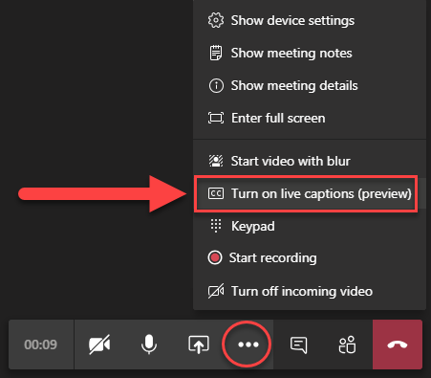
Turning captions on and off
Go to your meeting controls
Select More options > Turn on/off live captions

Slide 4
Land Acknowledgement
We wish to acknowledge this land on which the University of Toronto operates. For thousands of years it has been the traditional land of the Huron-Wendat, the Seneca, and the Mississaugas of the Credit.
Today, this meeting place is still the home to many Indigenous people from across Turtle Island and we are grateful to have the opportunity to work on this land.
Notes:
[‘Land Acknowledgement’ slide]: Before we begin
“We wish to acknowledge this land on which the University of Toronto operates. For thousands of years it has been the traditional land of the Huron-Wendat, the Seneca, and the Mississaugas of the Credit. Today, this meeting place is still the home to many Indigenous people from across Turtle Island and we are grateful to have the opportunity to work on this land. We thank our ancestors including the land as life for allowing us to be here today.”

Slide 5
Housekeeping
This webinar is being recorded
& transcribed
Presenter slides will also be shared
Please mute your audio and turn off your video
We will hold questions until the end
A link to the recording will be sent to all participants after the session
Please put questions into the chat box

Slide 6
Agenda
Time | Topic
10:30 am-10:35 am | Welcome & Housekeeping
10:35 am-10:45 am | Overview of SSHRC Insight Grant with Mark Bold
10:45 am-11:35 am | Faculty Panel and Q&A with Profs Becky Chen & Michael Miller
11:35 am-11:55 am | RSO Tips and Q&A with Mark Bold
11:55 am-12:00 pm | Closing Remarks

Slide 7
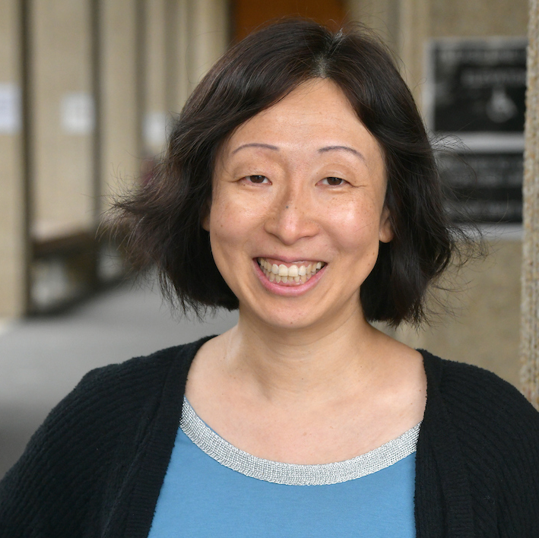
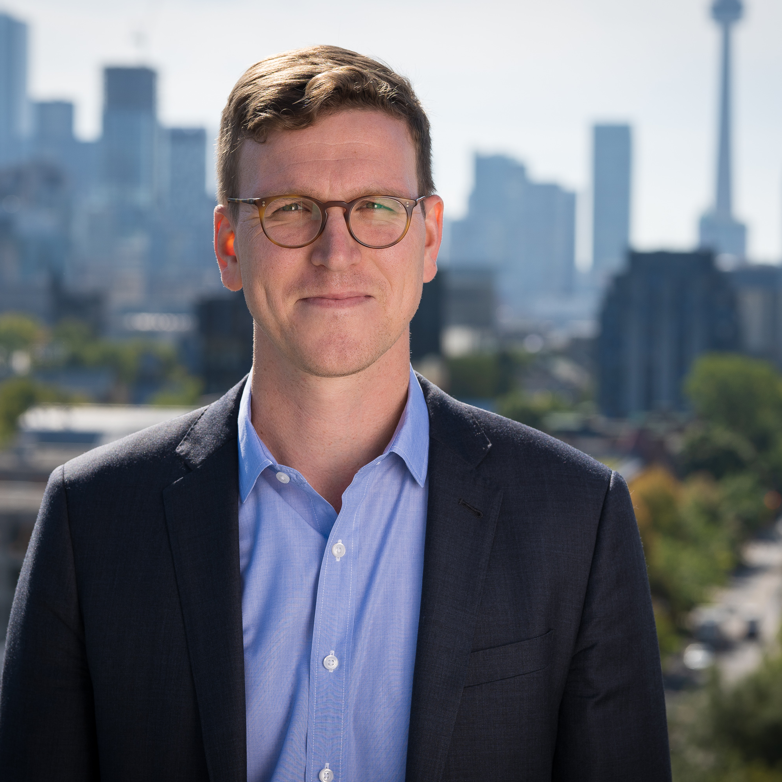
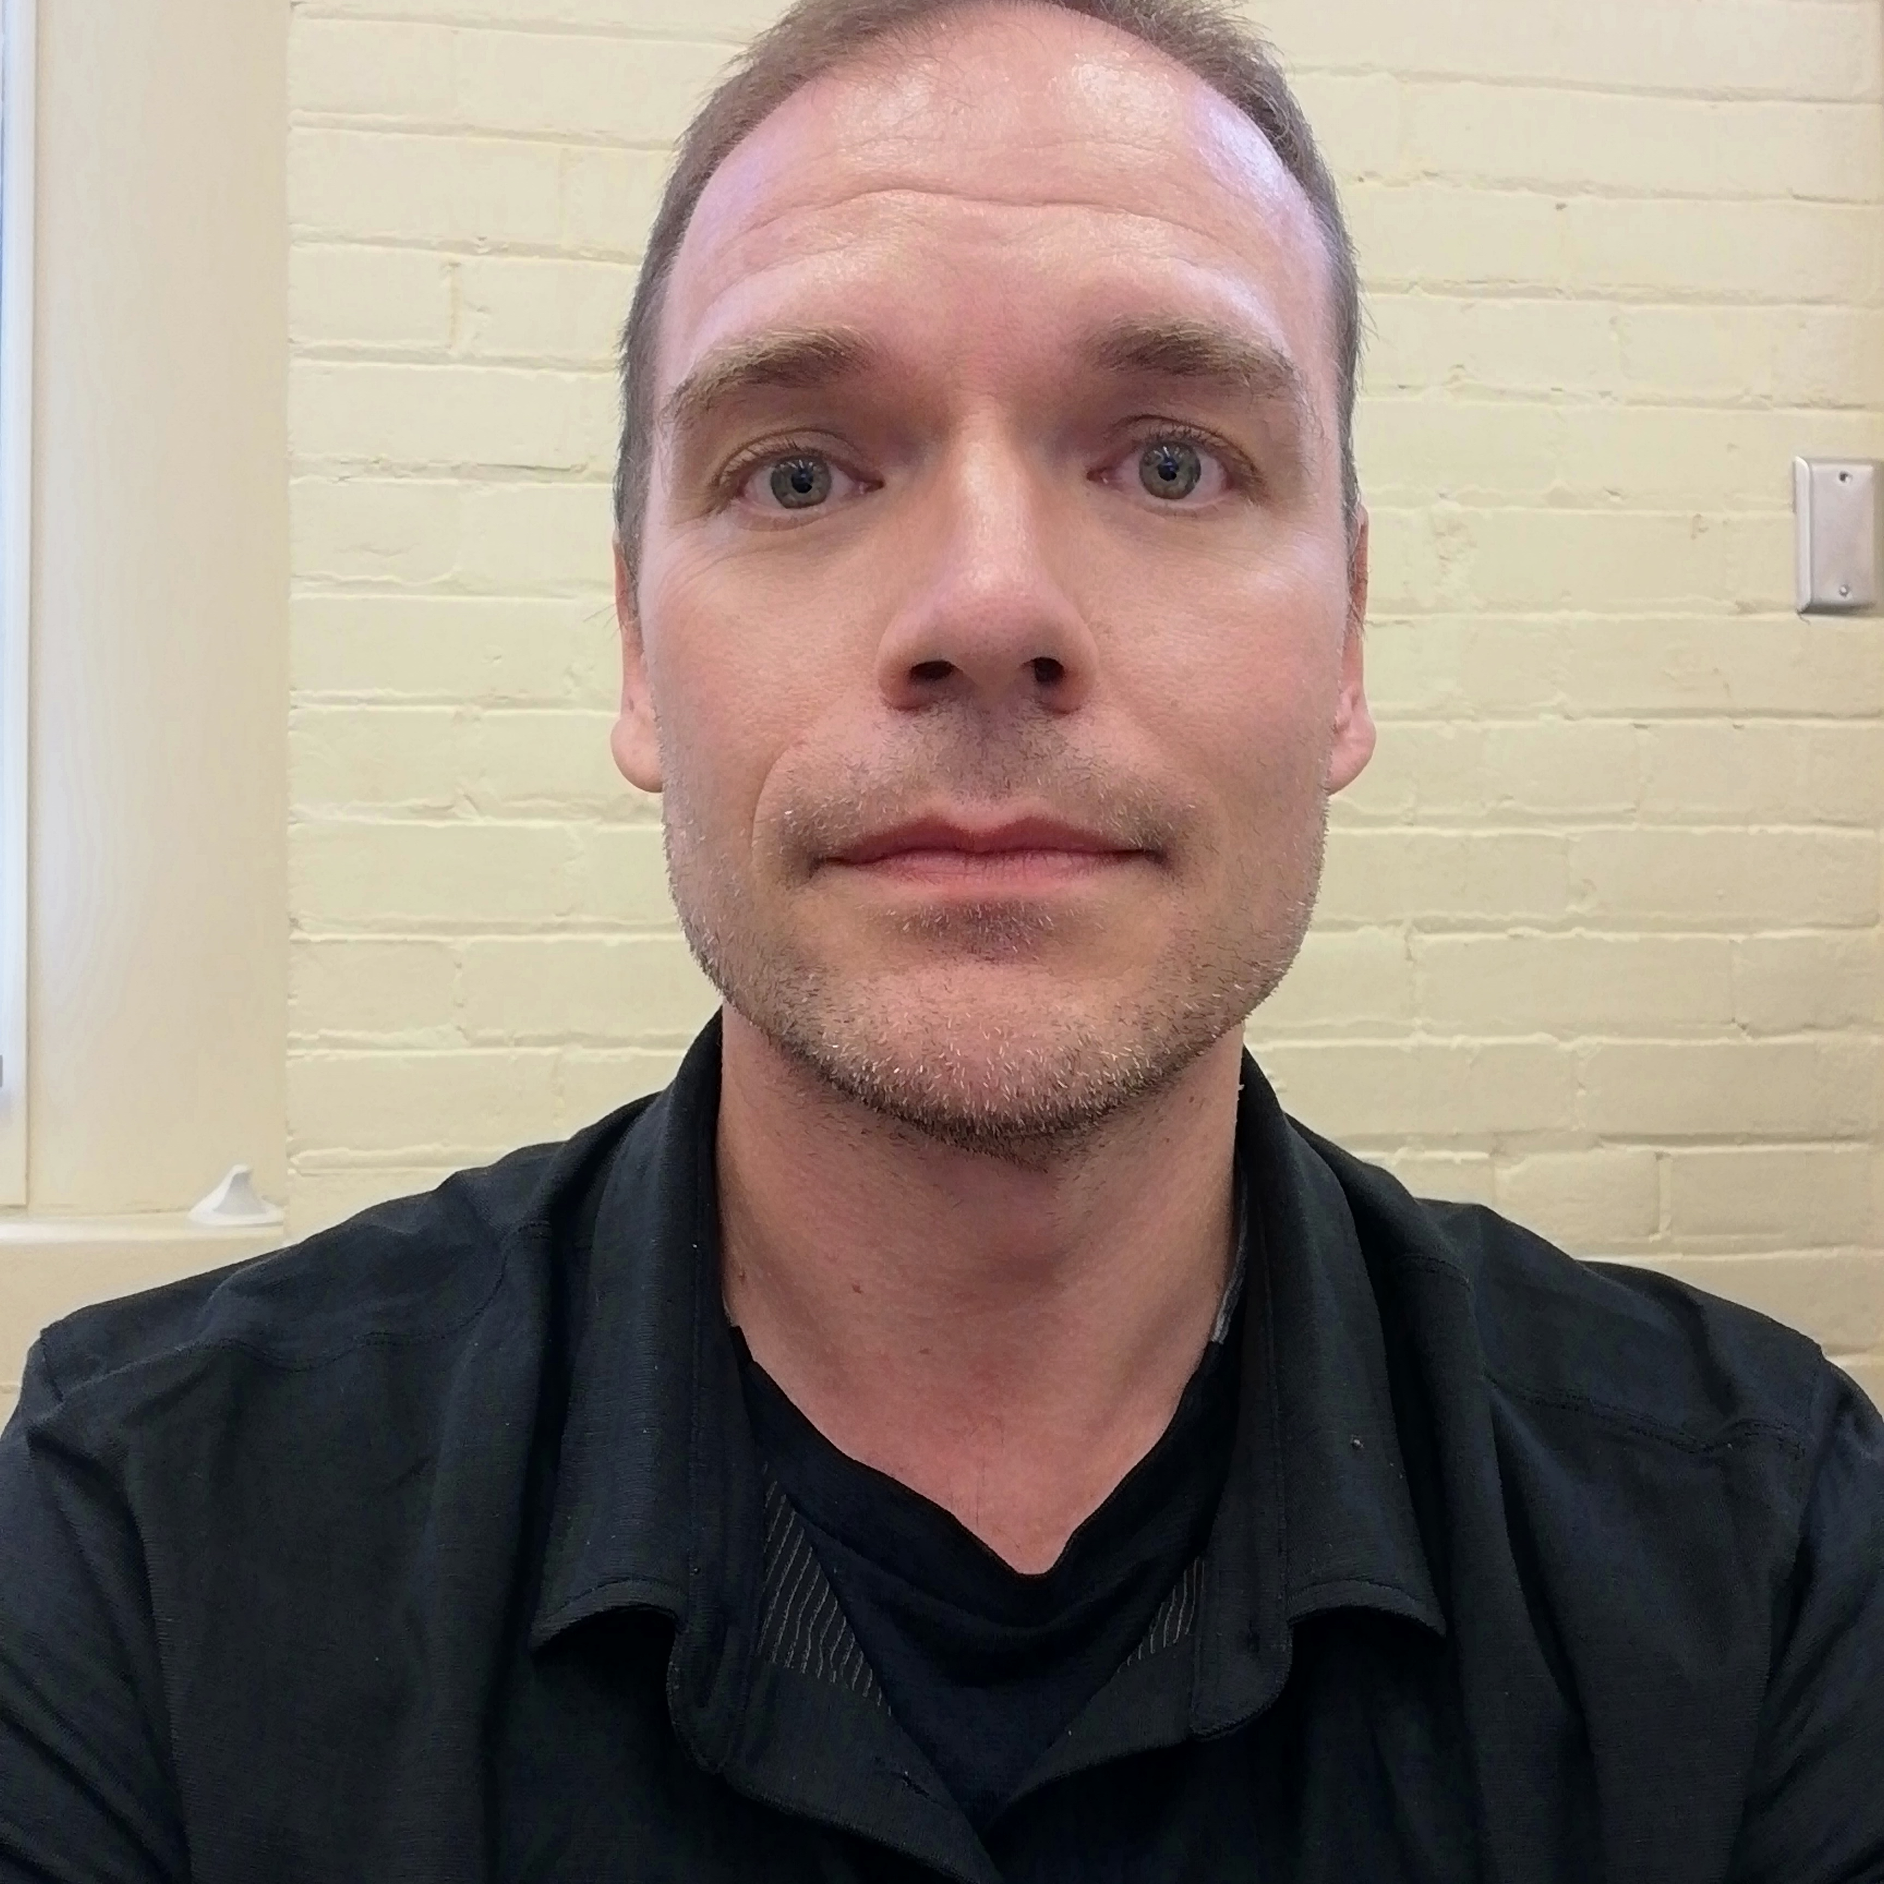
Presenters
Becky Chen
Michael Miller
Mark Bold
Professor, Applied Psychology and Human Development
Assistant Professor, Philosophy
Research Funding Manager, Social Sciences & Humanities, Research Services Office

Slide 8
Office of the Vice-President,
Research and Innovation
Insight Grant in brief
Most flexible SSHRC funding opportunity: short or long-term for any subject under SSHRC’s mandate
$7,000 to $400,000 over 2, 3, 4 or 5 years, maximum annual budget of $100,000
Applicants/Co-Applicants/Collaborators
Applicants can be emerging or established scholars
Applicants and Co-applicants: main affiliation with Canadian postsecondary institution (int’l co-applicants not allowed)
Collaborators do not need this main affiliation
Evaluation criteria and scoring (for full criteria/sub-criteria, see IG webpage):
Challenge 40% (relevance, originality, theoretical framework, methodology, lit review, training, impact)
Feasibility 20% (budget, timeline, expertise of applicant/team, KM plan)
Capability 40% (past experience in research, KM, training & mentoring, impact on professional practices and policies)
Notes:
So, let’s talk about the Insight Grant in brief.
For those of you who have held SSHRC IGs in the past, my apologies if this information is redundant, but just in summary: the IG is intended to provide stable funding for long-term research initiatives, high-quality training for students, investigator-driven research, for any subject under SSHRC’s mandate. It is likely the most flexible, with the fewest strings, of any SSHRC funding opportunity.
The budgets can range from anywhere between $7,000 to $400,000, with a maximum annual budget of $100,000, and the duration of the grant can be 2, 3, 4, or 5 years.
- In terms of who can apply, it can be a single researcher or a team of researchers (where one person is designated the Applicant). And it doesn’t matter if one is an emerging scholar (that is, within their first 6 years of their academic appointment) or an established one, as either can apply and there is no funding envelope reserved for applicants in either category, unlike in the Insight Development Grant where 50% of the funding envelope is reserved for emerging scholars.
- Applicants and co-applicants for the IG application need to have their main academic affiliation be with a Canadian postsecondary institution. And when an Applicant applies, they need to do so through a SSHRC eligible institution. UofT is an eligible institution, so if you are applying through your appointment at UofT, and your appointment allows you to hold grants at the University, then you meet that eligibility criteria. However, if you have an appointment elsewhere (such as at one of the UofT affiliated hospitals), then it’s important to consider this, as most hospitals are not a SSHRC eligible institution.
- Collaborators on the other hand don’t need to be affiliated with an eligible Canadian postsecondary institution, so International scholars and non-academics can be collaborators.
- Looking at the evaluation criteria for the IG application, you may recognize the three criteria, as SSHRC use same criteria in all funding opportunities, just weighted differently depending on the specific funding opportunity and its objectives, the target audience, and other factors.
CHALLENGE refers to, broadly, the aim of the proposed research, so its significance and originality, the proposed methodologies, the appropriateness of the theoretical approach, the quality of the training or mentoring plan, and the potential impact of the research.
FEASIBILITY refers to, among other things, the proposed timeline, how sound is the proposed budget and the budget justifications, and the quality of the knowledge mobilization plan.
And CAPABILITY broadly refers to the quality, quantity and significance of your past experience and contribution record. The evaluation of your past experience will be based according to your career stage, but proposals are ranked and your contribution record is worth 40% of the final evaluation score.
A point of comparison could be the Insight Development Grant, where the Challenge portion of the evaluation criteria is worth 50%, while the Capability portion is only worth 30%, as that funding opportunity is primarily for novel research, or research that is early in it’s developmental stage, while the IG does favor novel research but also research that is somewhat in line with the applicant’s contribution record.

Slide 9
Office of the Vice-President,
Research and Innovation
Insight Grant in brief cont’d
 | 2019 |  | 2020 |  | 2021
 | UofT | national | UofT | national | UofT | national
Number of Eligible Applications | 141 (of 141) | 1425 | 119 (of 119) | 1213 | 88 (of 91) | 1084
Number of Awards | 78 | 580 | 70 | 637 | 57 | 560
Success Rate | 55.30% | 40.70% | 58.8% | 52.5% | 64.8% | 51.7%
Total Amount Requested | $24,491,355 | $263,695,102 | $20,740,358 | $224,744,976 | $14,984,492 | $210,915,050
Total Amount Awarded | $11,924,780 | $91,683,104 | $10,752,570 | $104,001,032 | $8,477,763 | $96,443,016
Average Request | $173,698 | $185,049 | $174,289 | $185,280 | $170,278 | $194,571
Average Grant | $152,882 | $158,074 | $153,608 | $163,267 | $148,733 | $172,220

Slide 10
Office of the Vice-President,
Research and Innovation
Insight Grant in brief cont’d
Funding streams
Stream A: requested budgets between $7,000 - $100,000
Stream B: requested budgets between $100,001 - $400,000*
*At UofT:
2019 Competition
70 stream A applications, 39 successful (56%) - 45.5% nat’l
71 stream B applications, 39 successful (55%) – 37.2% nat’l
2020 Competition
53 stream A applications, 31 successful (58%)
66 stream B applications, 39 successful (59%)
2021 competition
38 stream A applications, 30 successful (79%)
50 stream B applications, 27 successful (54%)
Notes:
- This year there will again be two funding streams that one can apply under:
Stream A, for projects with a proposed budget of between $7000 and $100,000
Stream B, for those with a budget between $100,001 and $400,000.
Both Streams are adjudicated by the same committee, following the same adjudication/merit review process, but SSHRC’s intention was to have a higher success rate for applications submitted under Stream A. SSHRC’s target I believe was between 5-7% more applications in Stream A would be successful compared to Stream B, and you can see the numbers for UofTs applicants that, at least for us, it was higher than that proposed targeted success rate.
However, saying that, SSHRC does not set aside a pre-defined or higher portion of the funding envelope for Stream A applicants, it will more depend on the number and quality of the proposals. Though in saying that, if you are just over the $100,000 threshold, then you may want to consider revising your budget so that you fit into the Stream A applications so that you could perhaps take advantage of that higher targeted success rate for Stream A.

Slide 11
Office of the Vice-President,
Research and Innovation
IG | IDG
Potentially large-scale initiatives that are more aligned with past research contributions | Short term projects, early stage research, clearly delimited
Challenge = 40%, Feasibility = 20%, Capability = 40% | Challenge = 50%, Feasibility = 20%, Capability = 30%
2-5 years, $7000 - $400,000 | 1-2 years, $7000 - $75,000
Int’l co-applicants not allowed | Int’l co-applicants allowed
No reserved funding envelope for Emerging or Established scholars, but Stream A has higher targeted success rate. | 50% of funding envelope reserved for Emerging scholars
Applications assessed by both SSHRC IG adjudication committee members and external assessors | Single-stage IDG adjudication committee review (no external assessors)
CV requirement for IG application: SSHRC CV (as part of the SSHRC application site) | CV requirement for IDG application: Canadian Common CV
Notes:
- IDG supports early stage research, and not intended to support large-scale initiatives. Long-term support for research that is more aligned with your past research history should be sought through the Insight Grant opportunity.
This is reflected in the “Evaluation criteria and scoring” of the two funding competitions: in the IDG, the “Challenge” criteria (that is the originality of the project, the methodology, the training/mentoring plan, the potential for impact) is worth 50%, whereas the “Capability” criteria (that is, the details of your past research, knowledge mobilization and training/mentoring experience) is only worth 30%. The IG, on the other hand, has both the Challenge and Capability criteria worth 40%, so the scoring matrix of the IDG emphasizes the project itself over past contributions, whereas the IG doesn’t necessarily do that.
- IDG is for 1-2 years ($7000 - $75,000), whereas the IG is 2-5 years ($7000 - $400,000)
- IDG may involve international co-applicants as long as they have a formal affiliation with a postsecondary institution. The IG, on the other hand, does not allow for international scholars as co-applicants (regardless of having that formal affiliation).
- In both the IDG and IG, Emerging and Established scholars can apply, but the IDG reserves at least 50% of its funding envelope for applications from Emerging scholars, whereas the IG has no reserved funding envelope for either.
Important to note: one cannot generally apply for an IDG and IG in the same calendar year. The last two years have introduced an exception to this in that if your IDG application was not successful, then you were allowed to apply for the IG in the Fall of that same calendar year, an in email correspondence with SSHRC, they said they will allow it again for 2019.
Also, if you applied for an IG in the most recent competition (that is, October 2018), then you can apply for the IDG in Feb 2019, but the objectives of your IDG project must be significantly different compared to those of your IG application.

Slide 12
Office of the Vice-President,
Research and Innovation
Eligibility
Eligibility to be the Applicant (SSHRC) – must have a formal affiliation with SSHRC-eligible Canadian postsecondary institution (primary affiliation cannot be with a non-Canadian postsecondary institution)
Eligibility to be PI (UofT)
Faculty
My Research Applications (MRA)
Access to MRA for Status Only or Retired/Emeritus
Exceptional cases (Teaching Stream, Librarians 3 or 4) – NOTE that as of Aug 4, 2022, Teaching Stream faculty members and Librarian 3 and 4 will be given the PI role in MRA (so all approvals will be done through MRA) – the UofT “Eligibility to be PI” guidelines will be updated by that time
Postdoctoral fellows and PhD candidates in final year
Apply directly to SSHRC (see “Administering Organization” section of IG application instructions for more)
Must hold appropriate affiliation within 5 months of the start date of the grant (i.e., by Sept. 1, 2023) ***
Co-applicant – same eligibility rules as the Applicant
Collaborator – no required affiliation (IG funds cannot be used for Collab research costs)
***NOTE: at UofT, the “appropriate affiliation” would be one that is eligible to be PI on a grant (as per “Eligibility to be PI (UofT)” guidelines/link referred to above). If you are a Postdoc or PhD student who is thinking of applying for the IG, please contact Mark Bold at Research Services (mark.bold@utoronto.ca) well before the IG deadline and before you start the application in order to clarify what this means in relation to your eligibility to hold the grant at UofT as the PI.
Notes:
In terms of ELIGIBILITY, there are a few important areas to highlight, and these are things which SSHRC and UofT will check and verify.
First, the ELIGIBILITY TO BE THE APPLICANT of the IG application from SSHRC’s point of view: you must have an appointment with a SSHRC eligible Canadian postsecondary institution, and that position must be one that allows you to be a PI on a grant. Applicants apply through their university, so when you complete the SSHRC online application with UofT as the administering organization and hit the “submit” button, then the application is not forwarded to SSHRC, but instead goes to our UofT research office. We conduct an administrative review of the application, mostly related to eligibility questions, and if all is well, then we forward the application to SSHRC (and if we notice any issues with the application, then we have the option to send it back to the applicant in order to make any revisions). By forwarding an application to SSHRC, we are confirming that the applicant is eligible to hold a grant at the university.
At UofT faculty—in addition to submitting the SSHRC application on the SSHRC site—also submit a record of the application through UofT’s internal MRA online application.
MRA uses HR status to determine the eligibility to hold an award under Provost guidelines. Once you submit your MRA, it first goes through your administering unit/department for review and approval before arriving at the Research Services Office.
Some points about the MRA:
Access to MRA is determined by eligibility to hold an award at UofT (these are covered in the Provost’s guidelines, which are available on our site, and the link is in this slide)
Status only and emeritus academic appointments are eligible but you may not have MRA access set up
If there is any question about your eligibility to be a PI at UofT or your access to MRA, then please contact your Chair or unit head (eg lecturers, librarians 3 and 4). You may get permission to apply as an exceptional case, and if so, you will be given MRA access, but this process takes some time to go through, so better to inquire sooner rather than later.
POSTDOCTORAL FELLOWS and PHDs can apply but a couple of things:
You can’t apply with UofT as the administrative organization. Instead, you apply directly to SSHRC and you would leave the administrative organization field in your application blank.
Also, Postdocs and PhD students will need to establish the necessary affiliation with a Canadian post-secondary institution by Sept 2019 in order for SSHRC to release the funds if their application is successful. The “necessary affiliation” in this case would mean a position where the institutional guidelines allow you to hold a grant, and your position is secured for the duration of the grant.
We’ve already spoken about co-applicants and collaborators a bit, but in terms of the application module, to add co-applicants and collaborators you invite them through your application - No signatures needed
Co-applicants – must be affiliated with a postsecondary institution in Canada, and can be accountable for grant funds & incur expenses
Collaborators – do not need an affiliation with a postsecondary institution in Canada, and they can’t be accountable for grant funds but can claim expenses for travel for research planning and dissemination

Slide 13
Office of the Vice-President,
Research and Innovation
Eligibility cont’d
If you applied (as main applicant) for the 2022 IDG and were unsuccessful, then you may apply for the 2022 IG (but not if your 2022 IDG was successful).
If you apply for the IG in Oct 2022, then you can also apply for IDG in Feb 2023, but objectives must be significantly different.
Current IG holders: Can submit if you currently hold an IG award, but only if in final year (that is, the year in which you received your final grant instalment (usually the year before your final automatic extension year))

Slide 14
Office of the Vice-President,
Research and Innovation
Eligibility cont’d
Subject matter – Applications must meet two criteria:
The proposed research or related activities must be primarily in the social sciences and humanities (i.e., aligned with SSHRC's legislated mandate).
The intended outcome of the research must primarily be to add to our understanding and knowledge of individuals, groups and societies—what we think, how we live, and how we interact with each other and the world around us.
If your application is Health- or Psychology-related – check guidelines, but most importantly speak to SSHRC IG program staff (insightgrants@sshrc-crsh.gc.ca)
Projects whose primary objective is curriculum development, program evaluation, preparation of teaching materials, organization of a conference or workshop, digitization of a collection, or creation of a database are not eligible for funding
Joint initiatives
Sport Participation Research Initiative (SPRI)
Department of National Defence (DNDRI)
Notes:
In terms of SUBJECT MATTER eligibility: the Subject matter of your proposal must fall under SSHRC’s mandate, the aim of which is broadly to support research that primarily adds to our understanding and knowledge of individuals, groups and societies. You can read SSHRC’s mandate and subject matter eligibility document online for some direction. For Health-related research, SSHRC suggests that you look to CIHR’s mandate first to see if your project would be eligible for funding from them. Examples of health-related research that are not eligible for SSHRC funding clinical research, epidemiology, kinesiology, or clinical education of health care professionals (among others). SSHRC also has guidelines concerning the funding of applications related to Psychology, as they do support projects in the broad areas of social, developmental, personality and educational psychology, but does not support clinically oriented research with an intent to improve health, or research involving clinical trials.
So if you have questions about the eligibility of the subject matter of your proposal in relation to SSHRC’s mandate, then please read the guidelines on the SSHRC site, take a look at the CIHR programs, and if in doubt contact a SSHRC program officer through the email or phone number listed on the funding opportunity.
COMMITTEE: In your application, you will be asked to choose your preferred adjudication committee, and in a separate part of the application you will be asked to enter keywords, disciplines, and areas of research that best describe your proposal. You should choose your committee and your keywords carefully, as both will be taken into account by SSHRC program staff when they conduct their initial review of your application, they will use these in order to determine the committee that will be reviewing your application. SSHRC also suggests that if your proposal falls between committees, then you should choose the one that is closest to your primary discipline. If your proposal is multidisciplinary, then you can choose one of the multidisciplinary committees, but you’ll also have to provide a one-page justification for choosing that committee.
If you are having trouble deciding which committee to choose, then you could look at last year’s committee structure to see how they were put together and the members that were on them, or contact the SSHRC program staff for advice.
INDIGENOUS RESEARCH: If your proposal involves Indigenous research, then you will be able to specify that in your application. You can check on the SSHRC website for their definition of Indigenous research and their separate document concerning the merit review of Indigenous research. If your proposal does fall under Indigenous research, then the committee will review it with the guidelines for the merit review of Indigenous research in mind, and if there are enough proposals that fall under Indigenous research, then the committee will be composed in part or entirely of members with expertise in Indigenous research.
RESEARCH-CREATION: Research Creation is broadly defined by SSHRC as research that combines creative and academic research practices, where the creation process is situated within the research activity and produces critically informed work in various media. This is a specialized committee, so if you are unsure if your proposal falls under research creation, then read SSHRC’s documentation online or speak to the program staff.
JOINT INITIATIVES: There are a number of joint initiatives connected to the IG grant.
The SPRI offers supplements of $20,000 for successful IG applications, or for unsuccessful applications that were ranked highly but did not get funded, your application would be forwarded to Sport Canada for review and could receive funding up to $250,000.
The DND initiative supplemental funding of $20,000 per year for 3 years for successful IG applications.
Both the SPRI and DND initiatives require a one-page explanation in your application that details how your proposal falls under those joint initiatives, so you can go to the funding opportunity or the application instructions to read about what those initiatives entail.
The CFI initiative (for infrastructure funding) and Mitacs initiative (for additional funds to support students in your project) both require additional/separate applications.
The Initiative for Digital Citizen Research is a joint initiative with the Dept of Canadian Heritage and is related to projects researching the uses and effects of disinformation, and the grants are worth up to $250,000 over 3 years, or successful applications may be eligible to receive supplementary funding of $20,000 that is in addition to the IG funds approved by SSHRC.
Again, you can just go online to read the descriptions of each joint initiative to see if your proposal falls under any of them.

Slide 15
Office of the Vice-President,
Research and Innovation
Adjudication Committee
Applicants select their preferred adjudication committee (choose the committee that is most appropriate based on subject/discipline) – see here for past adjudication committees
Multi/interdisciplinary evaluation: if you select this, you must complete a one-page justification (explaining how your research will integrate elements (eg, theories, methodologies) from two or more disciplines)
Tri-Agency Interdisciplinary Peer Review Committee: intended for applications proposing research across disciplines/subject areas related to two or more of (1) social sciences & humanities, (2) natural sciences and engineering, and (3) health and wellness (subject matter still needs to fall under SSHRC’s mandate). Will be composed of peer reviewers active in interdisciplinary research who will be recruited in response to the applications that are submitted, using its own Evaluation Criteria (select “Committee 24” and complete one-page justification)
Indigenous Research: if your proposal falls under SSHRC’s definition of Indigenous Research, then your proposal can be identified as such, and would be adjudicated under SSHRC’s Guidelines for the Merit Review of Indigenous Research
Research-Creation: please see SSHRC’s definition of Research Creation (an approach to research that combines creative and academic research practices, where “creation” is situated within research with a resultant creative/artistic work). If your proposal aligns with SSHRC’s definition, then you can denote this (and, if appropriate, you could choose to have your proposal adjudicated by a Fine Arts-Research Creation committee).

Slide 16
Office of the Vice-President,
Research and Innovation
Adjudication Committee
Past IG Literature adjudication committee – example of diverse research interests
Chair: Literary and cultural history of the long 18th century in Britain, narrative studies, gender and sexuality theory
Member 1: Victorian literature and culture, the history of media and technology, sound studies, contemporary American poetry, and Canadian poetry
Member 2: 19th century literature, Literature and Anthropology, French literature
Member 3: Old English, Middle English, Renaissance Literature, History of the Book
Member 4: AI/Robotics and literature, Modern/Postmodern novel
Member 5: 19th and 20th century French literature, Gender and Sexuality Studies, Québec and francophone literatures
Member 6: Romanticism, 18th and 19th century literature and visual culture, history of museums and collections

Slide 17
Office of the Vice-President,
Research and Innovation
Adjudication Committee
Past IG Multidisciplinary or interdisciplinary social sciences adjudication committee – example of diverse research interests
Chair: language variation and change, linguistic heterogeneity, varieties of English
Member 1: social and political implications of new media, global communications, media and crime, and Arab media and politics
Member 2: attention and memory, auditory and visual perception, psychology and sport
Member 3: intellectual property, health law, and bioethics
Member 4: surveillance studies, smart cities and ubiquitous computing, urban studies, literature and film
Member 5: resilience and psychosocial stressors, family caregiving for persons with Dementia or recovering from stroke, disaster response and high risk populations
Member 6: Canadian and American foreign policy, Latin American and Caribbean politics with an emphasis on Cuba, and international relations

Slide 18
Office of the Vice-President,
Research and Innovation
Panel - Adjudication Process
& Proposal Tips
Professor Becky Chen
Full Professor, Applied Psychology and Human Development, OISE
SSHRC IG awardee
2021 SSHRC IG adjudication committee member (Chair of Committee 12A: Education and social work)
Professor Michael Miller
Assistant Professor, Department of Philosophy
SSHRC IG awardee
2021 SSHRC IG adjudication committee member (Committee 22: Multidisciplinary or interdisciplinary humanities)

Slide 19
SSHRC Insight Reader
Evaluation Forms

Slide 20
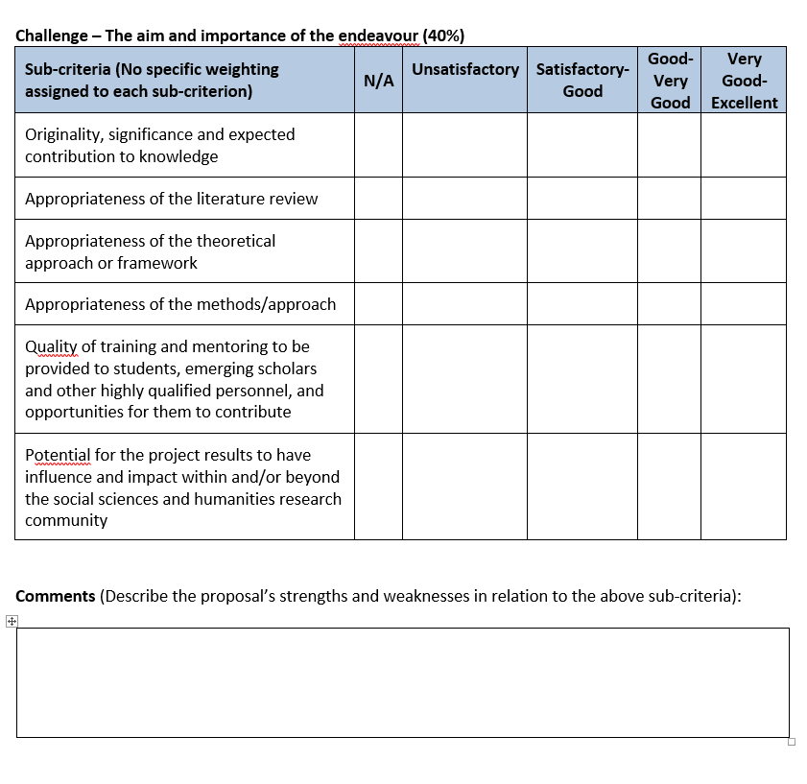

Slide 21
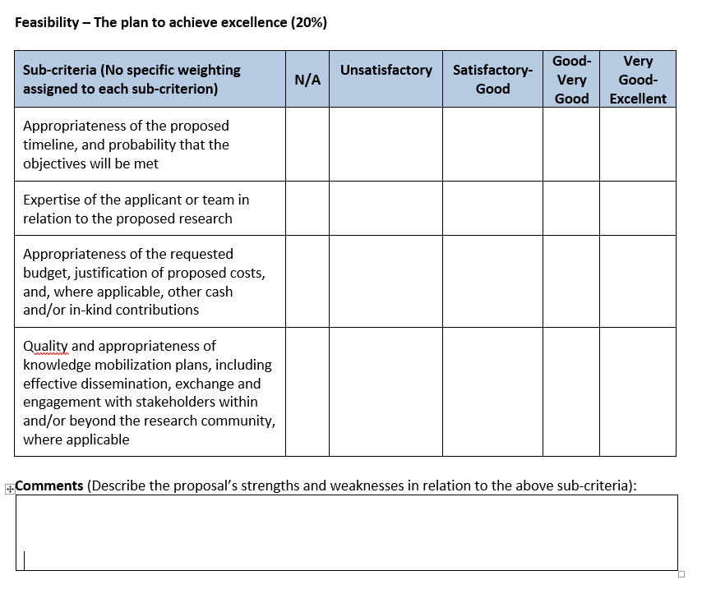

Slide 22
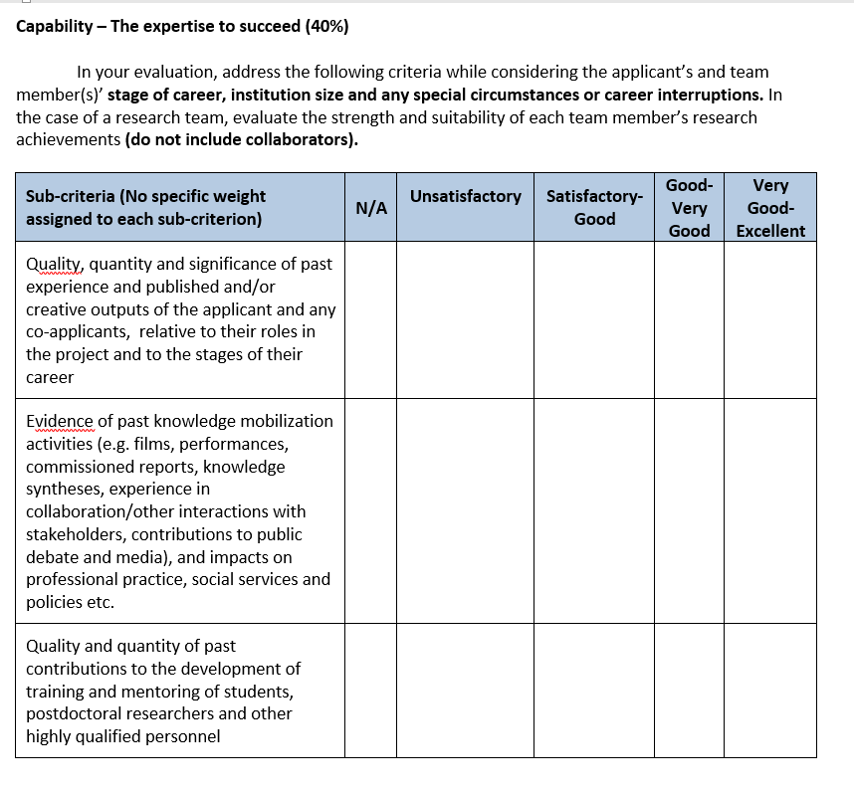

Slide 23
Q & A #1 – How to ask questions
Please use the chat
Click on the icon in the bottom menu to bring up the Meeting Chat pop-out window
Type your question and hit Enter on your keyboard or click the button to submit.
We will not be using the “Raise your hand” feature.
Please note: You may be asked to Unmute to clarify your question

Slide 24
Office of the Vice-President,
Research and Innovation
Impacts of COVID-19
IG application instructions (https://www.sshrc-crsh.gc.ca/funding-financement/instructions/insight-savoir-eng.aspx) describe where one may (if appropriate) speak to the possible impact of the COVID-19 pandemic on the proposed research project, and also on how the pandemic has had an effect on the applicant’s previous or current research activities.
SSHRC notes that this is not a mandatory part of the application.

Slide 25
Office of the Vice-President,
Research and Innovation
Impacts of COVID-19
In the “Detailed Description” document
From the IG instructions: “Contingency plans related to the potential impact of the COVID-19 pandemic on your research project may be described in this section, if appropriate. This is not mandatory, but it may assist the merit review committee in assessing the feasibility of your proposal if your research plans are significantly disrupted (e.g., if international travel is not possible).”
2. In the “Career Interruptions and Special Circumstances” section of the “Research Contributions” document
Again from the IG instructions: “Career interruptions occur when researchers are taken away from their research work for an extended period of time for health, administrative, family or other reasons, or reasons related to the COVID-19 pandemic.
. . .
Special circumstances involve slowdowns in research productivity or any circumstances that impact the progression of academic careers in a distinctive way. Researchers can use this section to indicate that their research work was impacted by circumstances related to health (and/or disability), administrative, family, cultural or community responsibilities, socio-economic context, COVID-19, or other factors . . . Use this optional section to outline any career interruptions or special circumstances that have affected your research activities. Provide dates of interruptions and indicate the reason for the delay in general terms (e.g., illness, disability, family loss or illness, cultural or community responsibilities, socio-economic context, COVID-19).”

Slide 26
Office of the Vice-President,
Research and Innovation
Impacts of COVID-19
So not a mandatory part of the 2022 IG application, but…
A message during the pandemic from a SSHRC Senior Program Officer:
“Given the current COVID-19 situation, I suspect a committee will likely be looking critically at whether what is being proposed is feasible within the current context and whether any ongoing research remains incomplete.”
…so referring to the pandemic within the context of either contingency plans for your proposed IG project or career interruptions or slowdowns in research should be considered if appropriate for your proposal.*
*But just to be the devil’s advocate, a former committee member suggested that if a proposal is excellent, then the potential (negative) impact of the pandemic on the proposed project would not have a great impact on its chances of being funded.

Slide 27
Office of the Vice-President,
Research and Innovation
Budget
Minimum essential funding
Committee may recommend cuts if budget is deemed insufficiently justified or not appropriate
at 30% may fail on Feasibility
at 50% must fail on Feasibility
know the typical budgets in your field, unrealistically high or low budgets will lower score
justify all costs (HOW and WHY)
be consistent with proposal description
budget for any one year cannot exceed $100,000
do not include ineligible expenses
e.g. remuneration & travel for guest speakers and presenters, overhead, payments to Applicant/Co-Apps/Collabs.
Upon initial review, if 30% or more of budget is ineligible, then application will not reach committee
Research expenses for collaborators
avoid red flags!
Notes:
So moving onto budget considerations, or the Feasibility section of the merit review process, which is worth only 20% in the evaluation criteria, but one must pass this section in order for the proposal to have a chance to be funded. Just a few important things:
The SSHRC Program officer will flag ineligible expenses in your budget, if over 30% or more of your budget items are ineligible, then the proposal will be automatically disqualified
Once your proposal get to the adjudication committee, the Committee applies the principle of minimum essential funding, and can reduce your budget if it is insufficiently justified
A budget reduction by the committee may lower the Feasibility score, which will lower the overall score of your proposal.
If the committee decides that between 30 and 49 % of your budget is inessential, then they could choose to fail the proposal based on the Feasibility criteria.
If they find that 50% or more of the budget is inessential, then they must fail the proposal based on Feasibility.
Your budget demonstrates how thoroughly you have thought through your project, and how prepared you are to administer it. The Committee is made up of researchers and they will have knowledge of costs, so know the typical budgets in your field, and don’t be too high OR too low, as both will reflect poorly on the proposal.
Also, CHOOSE THE APPROPRIATE LENGTH OF TIME FOR YOUR PROJECT, and ensure your budget matches your activities and timeline
JUSTIFICATION: You will be required to justify all costs in your budget, and this justification comes in two parts: explain WHY something is an essential cost and effective use of the funds, and HOW the cost is calculated
Justification – 2 parts
Examples:
compensation for students in the project, you would show the level of student, their activities on the project, rate x hours (includes benefits and vacation pay) or the stipend amount
conferences and travel costs – explain why that conference is essential (as the committee may not be familiar with it). If you know when and where the conference will be, then great, include that. And then explain how the travel costs are calculated (so airfare or ground transportation costs + hotel + per diems * the number of nights * the number of people)
Some travel RED FLAGS that have been seen in the past are, for example, multiple trips to a single destination, or travel for purposes of research dissemination in year one – BOTH COULD BE ALLOWED, BUT YOU WOULD HAVE TO ADEQUATELY JUSTIFY THEM
Note that if a postdoc or PhD is a co-applicant or collaborator, they cannot be paid from the grant
Collaborators for whom expenses are claimed must have completed an invitation and profile

Slide 28
Office of the Vice-President,
Research and Innovation
Budget
In 2021 IG competition:
For UofT applicants, 57 applications out of 88 were funded
Of those 57 funded applications, 27 were fully funded (47.3%)
 | Stream A | Stream B
# of funded applications | 30 | 27
Total amount requested for funded applications | $2,652,653 | $6,848,325
Total amount awarded for funded applications | $2,459,805 | $6,117,688
Avg grant requested for funded applications | $88,422 | $253,642
Avg grant awarded for funded applications | $81,994 | $226,581
Avg budget reduction for funded applications | $6,428 | $27,061
# of FULLY funded applications | 16 (53.3%) | 11 (40.7%)
Avg budget reduction (for grants not fully funded) | $13,775 | $45,665
Amount of smallest budget cut | $1,500 (or 1.51% of proposed budget) | $4,500 (or 1.8% of proposed budget)
Amount of largest budget cut | $33,500 (or 34.72% of proposed budget) | $92,451 (or 29% of proposed budget)
Notes:
So moving onto budget considerations, or the Feasibility section of the merit review process, which is worth only 20% in the evaluation criteria, but one must pass this section in order for the proposal to have a chance to be funded. Just a few important things:
The SSHRC Program officer will flag ineligible expenses in your budget, if over 30% or more of your budget items are ineligible, then the proposal will be automatically disqualified
Once your proposal get to the adjudication committee, the Committee applies the principle of minimum essential funding, and can reduce your budget if it is insufficiently justified
A budget reduction by the committee may lower the Feasibility score, which will lower the overall score of your proposal.
If the committee decides that between 30 and 49 % of your budget is inessential, then they could choose to fail the proposal based on the Feasibility criteria.
If they find that 50% or more of the budget is inessential, then they must fail the proposal based on Feasibility.
Your budget demonstrates how thoroughly you have thought through your project, and how prepared you are to administer it. The Committee is made up of researchers and they will have knowledge of costs, so know the typical budgets in your field, and don’t be too high OR too low, as both will reflect poorly on the proposal.
Also, CHOOSE THE APPROPRIATE LENGTH OF TIME FOR YOUR PROJECT, and ensure your budget matches your activities and timeline
JUSTIFICATION: You will be required to justify all costs in your budget, and this justification comes in two parts: explain WHY something is an essential cost and effective use of the funds, and HOW the cost is calculated
Justification – 2 parts
Examples:
compensation for students in the project, you would show the level of student, their activities on the project, rate x hours (includes benefits and vacation pay) or the stipend amount
conferences and travel costs – explain why that conference is essential (as the committee may not be familiar with it). If you know when and where the conference will be, then great, include that. And then explain how the travel costs are calculated (so airfare or ground transportation costs + hotel + per diems * the number of nights * the number of people)
Some travel RED FLAGS that have been seen in the past are, for example, multiple trips to a single destination, or travel for purposes of research dissemination in year one – BOTH COULD BE ALLOWED, BUT YOU WOULD HAVE TO ADEQUATELY JUSTIFY THEM
Note that if a postdoc or PhD is a co-applicant or collaborator, they cannot be paid from the grant
Collaborators for whom expenses are claimed must have completed an invitation and profile

Slide 29
Office of the Vice-President,
Research and Innovation
Budget cont’d
3 questions that should be answered for each item in one’s budget:
How much? How did you calculate this cost? Why is this expense essential?
The budget is split into two sections*:
Funds requested from SSHRC (i.e., the budget table)
This section is just for the numbers (i.e., How much?)
The budget for any one year cannot exceed $100,000
Budget Justification document (max 2 pages)
Should be organized by budget category (i.e., categories listed in the “Funds requested from SSHRC” budget table)
Show HOW an expense was calculated and WHY it’s necessary for the project
HOW: Don’t make the reviewers do math, indicate how the # was calculated
WHY: link justification to your methodology – account for every dollar, justifications should align with the project description and other parts of application
*There is also a third budget-related section called “Funds from other sources”. For the IG, applicants are not obliged to include
contributions (ie, cash or in-kind contributions) from other sources, but if you do have these, then they can be included in this table,
and you should account for them in some way in your “Budget justification” document (ie, how are these funds from other sources
going to be used in relation (or in contrast) to the funds from SSHRC)
Notes:
Make it easy for committee members to understand how your justification relates to your methodology – account for every penny, there should be nothing in the justification that isn’t in the Description and vice versa
It’s best to avoid making committee members do the math, so indicate how the budget amounts are calculated.
There are no set rules on number or level of students, it just depends on your project and the resources you need to carry it out. Ensure you address criteria for meaningful involvement and training of students
State where possible you are using institutional rates
Justify the use of stipends clearly as these are not designated for a particular purpose, Stipends can be used to pay grad students or postdocs whose work is an integral part of your research project and where their activities can be described as part of their academic training
Avoid the perception that students are included because your dept expects you to provide support – instead you want to emphasize that the students are essential to the successful completion of the project.
Don’t just spread your budget evenly, or copy and paste from Y1 to Y2 - the budget should demonstrate that you have thought through the activities and personnel needed each year.

Slide 30
Office of the Vice-President,
Research and Innovation
Budget cont’d
Applicants should consult the Tri-Agency Guide on Financial Administration (Part 2: Use of Grant Funds), particularly the 4 basic principles that govern the appropriate use of grant funds, as grant expenditures must:
contribute to the direct costs of the research/activities for which the funds will be awarded, with benefits directly attributable to the grant [so the grant-related purpose for an expense must be clear, and it should be essential to the project]
not be provided by the administering institution to their research personnel
be effective and economical
not result in personal gain for members of the research team
Additionally, any institutional policies would apply (like those detailed in the UofT Guide to Financial Management (e.g., per diem rates)).
Notes:
Make it easy for committee members to understand how your justification relates to your methodology – account for every penny, there should be nothing in the justification that isn’t in the Description and vice versa
It’s best to avoid making committee members do the math, so indicate how the budget amounts are calculated.
There are no set rules on number or level of students, it just depends on your project and the resources you need to carry it out. Ensure you address criteria for meaningful involvement and training of students
State where possible you are using institutional rates
Justify the use of stipends clearly as these are not designated for a particular purpose, Stipends can be used to pay grad students or postdocs whose work is an integral part of your research project and where their activities can be described as part of their academic training
Avoid the perception that students are included because your dept expects you to provide support – instead you want to emphasize that the students are essential to the successful completion of the project.
Don’t just spread your budget evenly, or copy and paste from Y1 to Y2 - the budget should demonstrate that you have thought through the activities and personnel needed each year.

Slide 31
Office of the Vice-President,
Research and Innovation
Budget cont’d
(straight from the IG guidelines)
Specific rules for the use of grant funds
Insight Grant funds cannot be used for remuneration, and/or the travel and subsistence costs of presenters or guest speakers.
Insight Grant funds cannot be used to remunerate team members (applicant, co-applicant or collaborator). This includes postdoctoral fellows serving in any of these capacities.
Insight Grant funds cannot be used for collaborators’ research costs. However, their travel and subsistence expenses related to research planning, the exchange of information with the grantee, and for the dissemination of research results are considered eligible.
Consultation fees are eligible for expert and/or professional and technical services that contribute directly to the proposed research as long as the service is not being provided by a team member or other persons whose status would make them eligible to apply for a SSHRC grant.
Notes:
Make it easy for committee members to understand how your justification relates to your methodology – account for every penny, there should be nothing in the justification that isn’t in the Description and vice versa
It’s best to avoid making committee members do the math, so indicate how the budget amounts are calculated.
There are no set rules on number or level of students, it just depends on your project and the resources you need to carry it out. Ensure you address criteria for meaningful involvement and training of students
State where possible you are using institutional rates
Justify the use of stipends clearly as these are not designated for a particular purpose, Stipends can be used to pay grad students or postdocs whose work is an integral part of your research project and where their activities can be described as part of their academic training
Avoid the perception that students are included because your dept expects you to provide support – instead you want to emphasize that the students are essential to the successful completion of the project.
Don’t just spread your budget evenly, or copy and paste from Y1 to Y2 - the budget should demonstrate that you have thought through the activities and personnel needed each year.

Slide 32
Office of the Vice-President,
Research and Innovation
Budget Tips
Budget Do’s
Budget should strongly relate to methodology in proposal
Explain HOW amounts are calculated and WHY they are necessary
Follow institutional guidelines for student compensation (BO) and per diems ($80 domestic, $100 international)
Indicate hourly compensation (includes benefits and vacation pay)
Explain tasks students will do and why that level (undergraduate, Masters, PhD or postdoc) is appropriate
Justify use of stipends
Budget justification should mesh with other application sections (Detailed Description, Student Training & KM plan)

Slide 33
Office of the Vice-President,
Research and Innovation
Budget Tips
Budget Don’ts
Don’t include ineligible items – see the updated Tri-Agency guide: https://www.nserc-crsng.gc.ca/InterAgency-Interorganismes/TAFA-AFTO/guide-guide_eng.asp
Only direct costs for the research being proposed - No overhead or general administrative costs
No compensation-based costs for Research Team members (Applicant, Co-Applicants, Collaborators)
No costs for conference organization or travel/remuneration for presenters or guest speakers (but workshops are eligible if related to project objectives)
Primary project objective cannot be curriculum development, program evaluation, preparation of teaching materials, organization of a conference or workshop, digitization of a collection, or creation of a database
No research expenses for Collaborators (but travel and subsistence related expenses for KM events or research team meetings with PI are fine)
Don’t pad or inflate costs
Avoid:
Math errors
Multiple trips to one destination without justification
Hiring non-students without a clear justification
“Premature” expenses that could be a red flag (e.g., dissemination costs in Year 1 without proper justification)

Slide 34
Office of the Vice-President,
Research and Innovation
Budget cont’d
UofT SSHRC Insight Grant – Budget Information Session
Date: August 25th, 10:00 am - 11:00 am
Session Details & Registration

Slide 35
Office of the Vice-President,
Research and Innovation
Writing your proposal
Demonstrate how this new research builds upon past work
Follow all instructions (e.g., headings for “Detailed Description” section)
Attachments: comply with formatting specs and ensure correct version is attached (don’t be disqualified for omitting mandatory section)
Read guidelines on student training, Knowledge Mobilization
Text boxes: use preview to ensure text is visible/legible
Have proposal read by colleagues
Avoid typos and math errors – proof and polish!
Have co-applicants complete CV and “Research Contributions” doc as early as possible
Suggested Reviewers section: don’t drain the pool, offer direction
Write with committee/assessors in mind: address evaluation criteria thoroughly
Write for a multi-disciplinary committee (i.e, Academic audience/peers, but not necessarily specialists in your field)
Define all terms, do not assume anything is obvious

Slide 36
Office of the Vice-President,
Research and Innovation
Tips from previous committee members:
Provide sufficient detail to allow informed assessment by committee members
Coherence: connect goals of new or continuing projects with past/ongoing research
Be explicit as to whether or not the research is new, emerging, or a continuation
Take time to address/define your outcomes (traditional/activities/community partnerships)
‘Educate’ the committee - persuasive in demonstrating a range of research goals and objectives
Have your grant proposal read by colleagues who have had successful applications
Present a challenging topic (originality)- but novelty alone not enough, why important?
Convey and inspire confidence, and clearly establish the need for the research and funds
Strike a balance between ambition and realism
If you are an emerging scholar, discuss why you can do the proposed project
Plan, organize and monitor your project well
Methodology (specific in describing data, resources and procedures: who, what, where, how?)
Write the proposal for the project that you want to do, not for the kind of project that you think (or were told) has a better chance of being funded.
Notes:
–write applications clearly and simply
ensure that your literature review is recent and relevant
• don’t merely re-purpose an old application • do not write your application like a “thesis proposal” where everything has been done except for the data collection or running the model

Slide 37
Office of the Vice-President,
Research and Innovation
UofT Resources
Department/Division
Business officer (compensation, travel, supplies costs)
Grant writing support (peer review, archived applications, internal deadlines)
Dept/Divisional Research Facilitator (for proposal development/editorial services)
Guide to Financial Management: http://www.finance.utoronto.ca/gtfm.htm
UofT travel policies and per diems
UofT Centre for Research & Innovation Support (CRIS) : https://cris.utoronto.ca/
Central Research & Innovation hub (partnership between VPRI, UTL and ITS)
UofT Libraries
http://onesearch.library.utoronto.ca/triagencyopenaccesspolicy
Advice on compliance with Open Access Policy, publication
https://onesearch.library.utoronto.ca/researchdata
Advice on data management, DMPs
https://utsc.library.utoronto.ca/librarians
List of UTSC Library Liaisons to assist with OA pubs and DMPs
https://library.utm.utoronto.ca/scholarly-communications
UTM library info for help with OA pubs and DMPs
Notes:
In conversation about a week ago with Sarah Scott, we talked about making available the list of Library Liaison’s for each of the departments and other academic units here at UTSC. The librarians are contacts for assistance with SSHRC gran application Data Management plans and Open Access publishing venues, including T-Space.

Slide 38
Office of the Vice-President,
Research and Innovation
UofT Resources
Research supports/contacts at Divisional levels
Academic Unit | website/contact
Applied Science & Engineering | https://hub.engineering.utoronto.ca/research-services/
Architecture, Landscape & Design | https://www.daniels.utoronto.ca/people?field_positions_field_position_type=2
Arts & Science | https://www.artsci.utoronto.ca/about/glance/directory#research
Dentistry | https://www.dentistry.utoronto.ca/research
Education (OISE) | https://www.oise.utoronto.ca/research/RESOURCES_FOR_FACULTY/index.html
Information | https://ischool.utoronto.ca/faculty-staff/administrative-services/
Kinesiology & Physical Education | https://kpe.utoronto.ca/academics-researchbachelor-kinesiology-bkinfuture-students/contact-us
Law | Contact: research.law@utoronto.ca; kelly.nolan@utoronto.ca
Management | Contact: joannep.pereira@rotman.utoronto.ca
Medicine | https://temertymedicine.utoronto.ca/grant-development
Music | https://utoronto.sharepoint.com/sites/music/research
Nursing | https://bloomberg.nursing.utoronto.ca/research/contact-the-research-office/
Pharmacy | https://www.pharmacy.utoronto.ca/research/funding-opportunities
Public Health (Dalla Lana) | https://www.dlsph.utoronto.ca/research/services-for-researchers/
Social Work | https://socialwork.utoronto.ca/about-us/administration-staff/
UTM | https://www.utm.utoronto.ca/vp-research/research-office/contact-us
UTSC | https://www.utsc.utoronto.ca/research/contact

Slide 39
Office of the Vice-President,
Research and Innovation
UofT Resources
Research Services Office
Website: https://research.utoronto.ca/funding-opportunities/db/insight-grants
Tip-sheet at the above website
Research Services SSHRC team
Mark Bold, Research Funding Manager (mark.bold@utoronto.ca) – main RSO contact for IG
MRA
Login: https://easi.its.utoronto.ca/administrative-management-systems/my-research-mr/
Technical help and access: raise@utoronto.ca or 416-946-5000
Notes:
RESEARCH SERVICES OFFICE: this link is to our posting for the SSHRC Insight Grant. The Research Services website gives details on how to submit your proposal for institutional approval, internal deadlines, links to Tri-Agency and SSHRC documents (including the slides from SSHRC recent IG webinar)
I will try to upload a Tipsheet on our website: this tipsheet would have advice on completing individual sections, and much of it is based on feedback from past applications, or comments from past committee members and SSHRC program officers (however, the SSHRC documentation, such as the funding opportunity posting and the application instructions, should always be referred to, and if there’s any question about something then contact SSHRC for confirmation).

Slide 40
Office of the Vice-President,
Research and Innovation
SSHRC Resources
SSHRC IG funding opportunity description, link to application and application instructions
http://www.sshrc-crsh.gc.ca/funding-financement/programs-programmes/insight_grants-subventions_savoir-eng.aspx
Tri-Agency Guide on Financial Administration (TAGFA)
https://www.nserc-crsng.gc.ca/InterAgency-Interorganismes/TAFA-AFTO/guide-guide_eng.asp
SSHRC program staff (funding opportunity questions)
insightgrants@sshrc-crsh.gc.ca or 613-996-6976
Technical support for Application Form and CV
webgrant@sshrc-crsh.gc.ca or 613-995-4273
Notes:
Funding opp description includes:
Evaluation criteria – checklist for committee
Guidelines for Effective Research Training – frequently a weak area; complement academic training, and prepare students for careers within and beyond academe; includes examples of skills students can acquire, and types of activities in which they can be involved
http://www.sshrc-crsh.gc.ca/funding-financement/policies-politiques/effective_research_training-formation_en_recherche_efficace-eng.aspx
Refer to the Use of Grant Funds guide as you prepare your budget:
-general principles on what expenses are eligible
-examples of eligible and ineligible expenses in all categories
Note: the ineligible expenses are particularly useful – be sure not to include ineligible items
Vital document also once you are successful
Questions about the funding opportunity go to the SSHRC program staff:
eg whether your subject is eligible, or which committee is best suited to the proposal

Slide 41
Office of the Vice-President,
Research and Innovation
SSHRC Resources
SSHRC Insight Grants webinar
French language version: Thursday, Sept 1, 2022, 10 – 11:30 am (Webex link)
English language version: Thursday, Sept 1, 2022, 1 – 2:30 pm (Webex link)
For a list of upcoming SSHRC webinars, visit:
https://www.sshrc-crsh.gc.ca/funding-financement/webinars-webinaires/index-eng.aspx
Notes:
Funding opp description includes:
Evaluation criteria – checklist for committee
Guidelines for Effective Research Training – frequently a weak area; complement academic training, and prepare students for careers within and beyond academe; includes examples of skills students can acquire, and types of activities in which they can be involved
http://www.sshrc-crsh.gc.ca/funding-financement/policies-politiques/effective_research_training-formation_en_recherche_efficace-eng.aspx
Refer to the Use of Grant Funds guide as you prepare your budget:
-general principles on what expenses are eligible
-examples of eligible and ineligible expenses in all categories
Note: the ineligible expenses are particularly useful – be sure not to include ineligible items
Vital document also once you are successful
Questions about the funding opportunity go to the SSHRC program staff:
eg whether your subject is eligible, or which committee is best suited to the proposal

Slide 42
Office of the Vice-President,
Research and Innovation
Submitting your application/Deadlines
Complete a My Research Applications (MRA) record
https://easi.its.utoronto.ca/administrative-management-systems/my-research-mr/
Upload draft proposal, firm budget amount
Due at Research Services by noon on Thursday, September 22, 2022
Check with your dept/faculty/divisional research office for their internal deadlines (ie, for MRA or editorial review options)
Submit SSHRC application online
https://webapps.nserc.ca/SSHRC/faces/logon.jsp?lang=en_CA
Internal deadline for online submission through SSHRC website is 9 am, Wednesday, September 28, 2022
Notes:
The first internal deadline is for the MRA to reach our office, which confirms your eligibility
How long it will take to get the approvals and reach us depends on several things so submit it in plenty of time
-ask your department re their deadline and what they want in the MRA
-if you need to gain access to MRA, because you are retired, status only or an exceptional case for eligibility add extra time, the process is described in the User Guide
With approved MRA in place, you can continue to work on the proposal until noon Friday October 12
Verify - click on submit – proposal will be with RSO – admin review – institutional e approval forwards it to SSHRC by their deadline

Slide 43
Office of the Vice-President,
Research and Innovation
Remember the Oct 2019 IG deadline?
SSHRC’s final deadline was Tuesday, Oct 15, but UofT internal deadline for applications to be submitted to SSHRC site was Thursday, Oct 10
No issues if application was submitted by UofT internal deadline
For those that tried to submit Oct 14 or 15: days of timeouts, delays, multiple extensions from SSHRC, anxiety, and wasted hours

Slide 44
Office of the Vice-President,
Research and Innovation
Small tip
In the IG application, in the section called “Research Activity”, there is a sub-section concerning “Environmental Impact”
If you answer “No” to the first question (“Will any phase of the proposed research take place outdoors?”), then you are not required to answer questions A, B, C and D below that, so just leave them blank.
Many applicants answer “No” to the first question, but then (believing they have to answer A-D) answer “Yes” to question B (“Will any phase of the proposed research take place in a country other than Canada?”). But this is only relevant if you answer “Yes” to the first question.
If you answer “No” to the first question, but you also choose to answer questions A-D, and you answer “Yes” to (for example) question B, then you won’t be able to submit the application until you complete and upload the Environmental Impact form (but if you answered “No” to the first question, then the form is not relevant to your proposal)

Slide 45
Office of the Vice-President,
Research and Innovation
KEEP CALM
AND
JUSTIFY EVERYTHING
(and follow the IG application instructions)

Slide 46
Q & A #2 – How to ask questions
Please use the chat
Click on the icon in the bottom menu to bring up the Meeting Chat pop-out window
Type your question and hit Enter on your keyboard or click the button to submit.
We will not be using the “Raise your hand” feature.
Please note: You may be asked to Unmute to clarify your question

Slide 47
Upcoming Event:
Webinar and Discussion – SSHRC Insight Grant – Budget Information Session - Aug. 25, 2022
Date: Aug. 25, 2022
10:00 - 11:00 am
https://cris.utoronto.ca/featured-events/
Notes:
We have the following resources to share with you:
We have launched our Facilitation Toolkit to help you plan + facilitate highly effective collaborative engagements! Check out our guidelines, tools & templates. Link is in the chat.

Slide 48
Upcoming Event:
Webinar and Discussion – NFRF Exploration: Strategies for Success - Aug. 16, 2022
Date: Aug. 16, 2022
1:30 - 3:00 pm
https://cris.utoronto.ca/featured-events/
Notes:
You can also check out our video library for past SSHRC Partnership Program Series videos to learn more about models and strategies for success for the Partnership Development Grant and the Partnership Grant. Link is in the chat.

Slide 49
Thank you!
A link to the recording, presenter slides, and feedback form will be sent out after the session
Follow-up questions can be addressed to mark.bold@utoronto.ca
Prof. Becky Chen
Prof. Michael Miller
Mark Bold

