Slide 1
CFI INNOVATION FUND 2025 information session
Presented by:
Division of the Vice-President, Research and Innovation
September 23, 2024

Slide 2
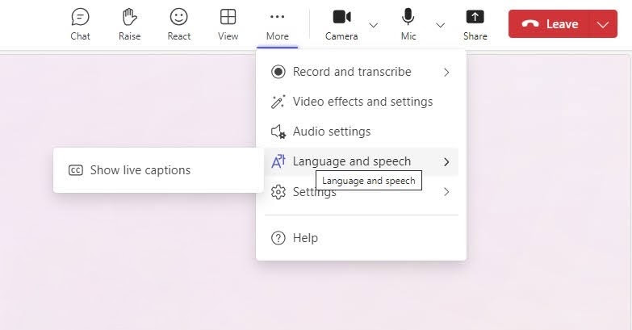
Housekeeping and Accessible Participation
Please mute your microphone and turn off your video.
We will be recording today’s session.
We will have time for questions following our speakers. To ask a question, you may use either the chat box or raise your hand.
To turn on live captions, select “More,” then hover over “Language and speech.”
Slides and the recording will be shared following the session.

Slide 3
Land Acknowledgement
We wish to acknowledge this land on which the University of Toronto operates.
For thousands of years, it has been the traditional land of the Huron-Wendat, the Seneca, and the Mississaugas of the Credit.
Today this meeting place is still the home to many Indigenous people from across Turtle Island, and we are grateful to have the opportunity to work on this land.

Slide 4
Speakers for Today
Kevin Hamilton
Director, Institutional Initiatives, Research Services​
Professor Aaron Wheeler
Department of Chemistry, Institute of Biomedical Engineering,
Lead of the successful CFI-IF 2023 application for “The CRAFT Diagnostic Horizons Lab” ($6.55M CFI award towards a total project budget of $17.5M)

Slide 5
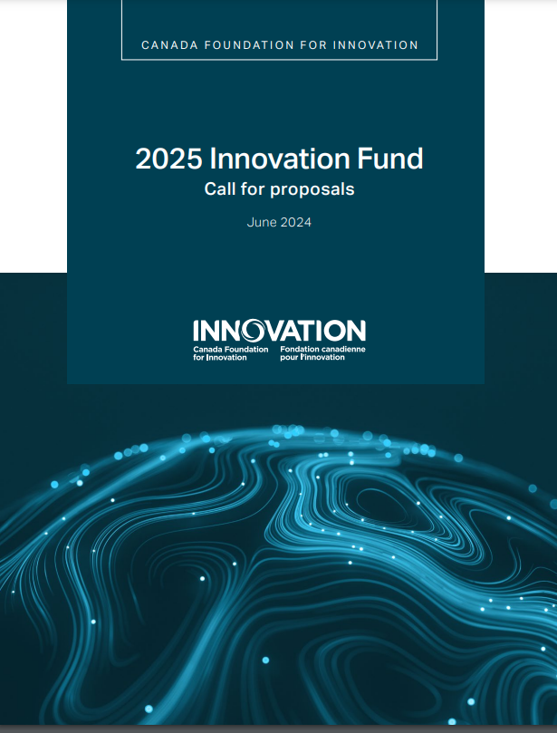
Agenda for Today’s Session
Focused on the IF2025 FULL proposal draft with a significant portion of the hour dedicated to Q&A
U of T and sponsor deadlines for the IF2025 competition
CFI review process
Key changes to application requirements in 2025
Budget preparation
Internal review of draft applications
Submission of FULL applications
VPRI supports
Insights from a successful CFI-IF project lead by Professor Aaron Wheeler

Slide 6
UofT IF 2025 Deadlines
Application Submission Deadlines
Ontario MCU launch of ORF-LIF | Mid-September 2024
CFI Notice of Intent (NoI) | 2 October 2024
Internal DRAFT Full Proposal | 18 November 2024
Feedback of RSO Reviews to Applicants | 6 December 2024
Internal FULL Proposal | 23 January 2025
CFI Full Proposal | 4 February
ORF-LIF FULL Proposal | x March 2025
Sponsor Decisions and Award Finalization
CFI BoD decision | November 2025
MCU ORF-RI decision | March 2026 (?)
CFI Finalization | August 2026
CFI Construction Initiation | May 2027

Slide 7
CFI Review Process
Expert Committees
Ratings based on assessment criteria
Meet “threshold of excellence” to move forward
Multi-disciplinary Assessment Committees (MAC)
Provides funding recommendations for each proposal
Expect increased scrutiny of project planning
Special Multi-disciplinary Assessment Committee (S-MAC)
Reviews MAC reports and recommendations for funding
Makes recommendations to the CFI Board of Directors

Slide 8
On-campus success rate
Over time, U of T applications have achieved mixed levels of success in the IF competitions:
The University continues to learn from previous competitions, and to encourage innovation and improve proposal quality. The internal proposal development processes and timelines are geared towards helping all proposals to be positioned for success.

Slide 9
Key Changes to Application Requirements for 2025 Competition
Assessment of EDI:
EDI previously assessed only under the Team Composition criterion
In IF2025, it will be assessed under the Research or Technology Development, Team, Sustainability and Benefits criteria
Emphasis on Project Maturity:
Project 'readiness'
Award finalization within nine months
Research Security Requirements:
National Security Guidelines for Research Partnerships
Sensitive Technology Research and Affiliations of Concern (STRAC)
Ontario Mitigating Economic and Geopolitical Risk checklist

Slide 10
Budget Preparation
Personnel, Construction and the 'last 20%'
These will require institutional cash
Full costing of line items:
Include: tax, delivery, installation
CFI will never supplement to cover an omission

Slide 11
Draft Application Requirements
RSO Internal Deadline for Draft of the Full Application: November 18th
To include:
PDF of application downloaded from CFI CAMS
Word versions of application attachments:
3-page summary;
25- or 30-page assessment criteria
Excel of Budget
PDF copy of any Research Security attachments submitted on CAMS
Package to be submitted by the Divisional Research Office to: rso.vpr@utoronto.ca

Slide 12
Draft Application Review
VPRI will administer the review of the application package:
Editorial Review of texts by the RSO editorial and EDI team
Admin Review of application completeness and budget by RSO
Peer Review by College of Reviewers
Research Security Review by the VPRI Research Security Team
Commercialization Plan Review by the IPO team (as appropriate)
Review of larger scale construction and renovation plans by UPD&C (as appropriate)
Advice from Core Facilities Working Group (as appropriate)
RSO will provide collective feedback from these reviews to Divisions by December 6th

Slide 13
Full Application: CFI and Ontario
CFI Applications
Deadline for submission of Full CFI Application on CAMS: January 23rd, 2025
Validate often!
RSO will undertake one further review of the application prior to submitting the applications on or before February 4th, 2025
Ontario Large Infrastructure Fund (LIF) Applications
Details of Ontario's matching funding programs are expected imminently.
Timelines are expected to be ~1 month later than CFI's

Slide 14
The VPRI support team
Kevin Hamilton
Process, timelines, eligibility (kevin.hamilton@utoronto.ca)
Elizabeth Nguyen
Policy and budget guidelines (elizabeth.nguyen@utoronto.ca)
Andrea Day & Emma Doran
Editorial feedback (on draft proposals) (andrealynne.day@utoronto.ca and emma.doran@utoronto.ca)
Andrea Gill
EDI (amk.gill@utoronto.ca)
Paul Jarrett & Colin Baulke
Research Security (researchsecurity@utoronto.ca)
Kristy Reynald & Glaucia Lima
Technology development (kristy.reynald@utoronto.ca and glaucia.lima@utoronto.ca)
General inquiries (rso.vpr@utoronto.ca)

Slide 15
VPRI resources to help you write your proposal
VPRI CFI Innovation Fund funding opportunity page (including the TIPS sheet)
U of T RSO CFI IF2025 Tips Sheet: Streams 1&2 and Stream 3
CFI IF 2025 Budget Template
VPRI Handbook on EDI in Teams and Training
U of T Commercialization Framework
VPRI Research Security page

Slide 16
Insights from a successful CFI IF project lead
Professor Aaron Wheeler
Department of Chemistry and Institute of Biomedical Engineering
Project Lead on 2023 IF application: The CRAFT Diagnostic Horizons Lab
CFI Award: $6,550,000
Total Project Cost: $17,548,543

Slide 17
QUESTIONS
Please type your questions into the chat box or use the Raise Hand function.

