Slide 1

Office of the Vice-President,
Research and Innovation
Agenda
  The Insight Grant in brief
  Eligibility Overview
  Insight Grant Statistics
  Panel – Adjudication Process & Proposal Tips
  Q&A #1
  Proposal Development- Budgets
  Timeline and Submission
  Webinar & Resource
  Research Security
  Q&A #2
  Appendix

Slide 2
Office of the Vice-President,
Research and Innovation
Research Security
1. Policy on Sensitive Technology Research and Affiliations of Concern (STRAC)
On January 16, 2024, the Government of Canada announced the Policy on Sensitive Technology Research and Affiliations of Concern (STRAC). Effective as of May 1, 2024.
The policy operates using two lists that must be used in conjunction:
1) Sensitive Technology Research Areas (STRA) List
2) Named Research Organizations (NRO) List
Grant applications that involve conducting research that aim to advance a STRA will not be funded if any of the researchers supported by the grant are affiliated with, or receiving funding/in-kind support from institutions that could pose a risk to Canada’s national security.
In the application, applicants will be asked if the proposed research aims to advance STRA.
  If the answer is “no”, no further action is required.
  If the answer is “yes”, applicants and other named roles must complete an Attestation Form, to certify non-affiliation with an NRO, and include this in the application form.
* National Security Guidelines for Research Partnerships (NSGRP) - research security process for grant applications involving private sector partner(s). Now only applicable for Canada Biomedical Research Fund
(Stage 2). Currently N/A for IG grants but will update in case of change.
Notes:
There is a significant change in this year's IG competition is research security section, as the Government of Canada's policy on research security is effective as of May 1, 2024. I will invite Edward Kim, research security advisor, to give us more information on this topic.

Slide 3
Office of the Vice-President,
Research and Innovation
Research Security
SSHRC resources for Research Security:
Tri-agency guidance on research security (guidance on STRAC & NSGRP)
National Security Guidelines for Research Partnership (NSGRP)
Policy on Sensitive Technology Research and Affiliations of Concern (STRAC)
  Sensitive Technology Research Areas (STRA)
  Named Research Organizations (NRO)
U of T resources for Research Security:
U of T Safeguarding Research
U of T STRAC Policy information website.
UTM Research Security information website.
U of T Research Security contacts:
General inquiries: researchsecurity@utoronto.ca
List of specific contacts at OVPRI: https://research.utoronto.ca/contact-us (search under “research security” to view a list of contacts to see who supports your division)
***NOTE that more slides with additional information about these research security elements of the IG application are included in the appendices of this slide deck for your reference
Notes:
Here are the resources useful for deepening your understanding for the research security.
The Research Security Advisors have client responsibilities for Divisions and the research security requirements for specific funding programs​

Slide 5
Office of the Vice-President,
Research and Innovation
Research Security – additional information
Those with named roles must provide the completed attestation forms to the applicant, who must save them as a single PDF and upload it to the STRAC Attestation Module of the application form .
For application aiming to advance a STRA, the inclusion of completed attestation forms is an eligibility issue. However, whether an application aims to advance a STRA or not will not affect merit review.
If an application aiming to advance a STRA is successful, any post –award additions of participants with named roles will require completed attestation forms.
Grantees must also inform SSHRC if the nature of their research evolves such that activities supported by the grant would aim to advance a STRA. Grant recipients cannot proceed with these new research activities until the appropriate granting agency’s approval has been obtained .
For further guidance and FAQs: https://science.gc.ca/site/science/en/safeguarding-your-research/guidelines-and-tools-implement-research-security/sensitive-technology-research-and-affiliations-concern/frequently-asked-questions-faq-policy-sensitive-technology-research-and-affiliations-concern

Slide 6
Office of the Vice-President,
Research and Innovation
Research Security – additional information
Are any of the researchers with named roles in the grant application affiliated with, or receiving funding or in-kind support from a university, research institution, or laboratory on the Named Research Organization List?
Will your grant will aim to advance any Sensitive Technology Research Arears?
YES
NO
NO
YES
Application not required to include attestation form(s), no further action needed.
Application requires completed attestation form(s). Attestation would not exclude the grant application form receiving federal funding.
Application is ineligible.

Slide 7
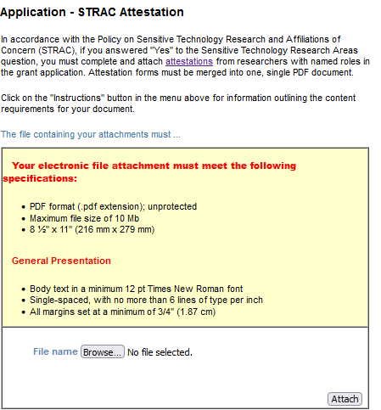
Office of the Vice-President,
Research and Innovation
Research Security – additional information
“Will the proposed research activities supported by this grant aim to advance any of the listed Sensitive Technology Research Areas?” – if “yes”, the “STRAC Attestation” section must be completed

Slide 8
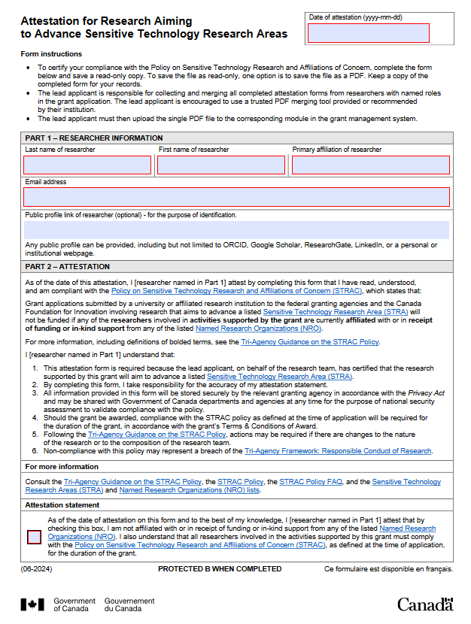
Office of the Vice-President,
Research and Innovation
Research Security – additional information – Attestation form
The link to the attestation form is available in the IG application instructions, in the “STRAC Attestation Module” section: https://www.sshrc-crsh.gc.ca/funding-financement/instructions/ig-ss/applicant-candidat-eng.aspx#STRAC-RTSAP

Slide 9
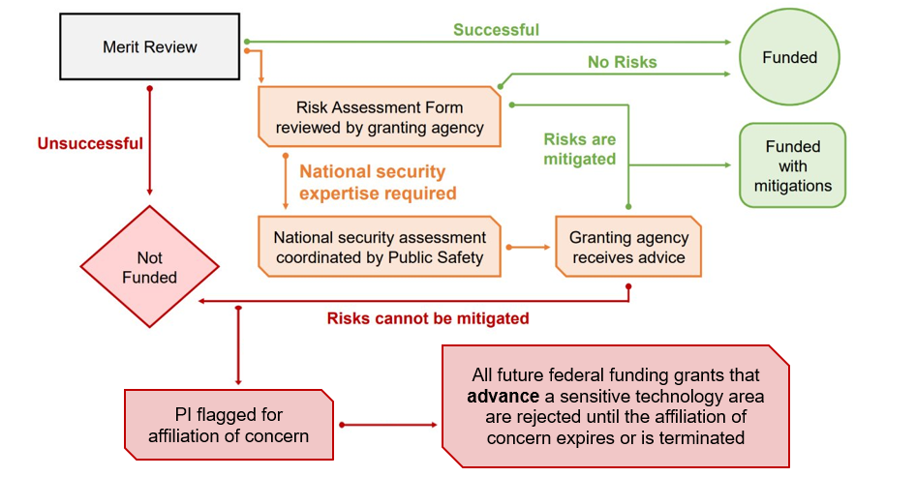
Office of the Vice-President,
Research and Innovation
Research Security – additional information – National Security
Guidelines for Research Partnership (NSGRP) Risk Assessment

Slide 10
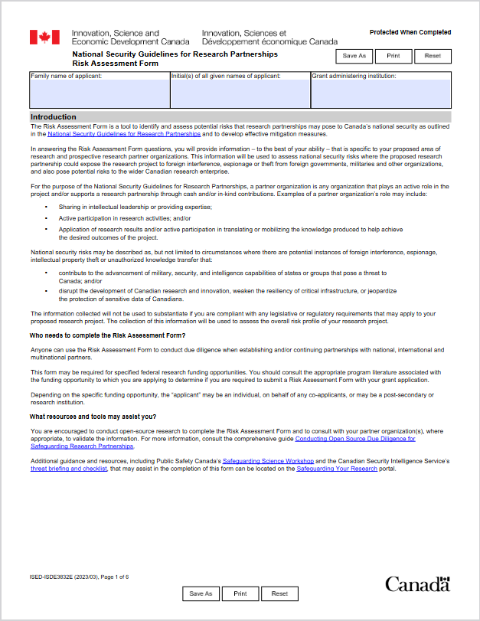
Office of the Vice-President,
Research and Innovation
Research Security – additional information – RAF
The link to the Risk Assessment Form (RAF) is available here: https://science.gc.ca/site/science/sites/default/files/attachments/2023/risk_assessment_form_ISED-ISDE3832E.pdf

